Slide 1
Information on a planned FAO TCPf project on
aquatic genetic resources in Central and Eastern Europe
Peter Lengyel
Research Institute for Fisheries, Aquaculture and Irrigation,
Szarvas, Hungary

Slide 2
Importance of aquatic genetic resources
Basis for: aquaculture development,
selective breeding programmes
restocking programmes, etc.
Increasing number of farmed fish strains and hybrids
Increasing number of genetic applications for answering the growing demand for fish products
Increasing challenges for sustainable management of these resources

Slide 3
Challenges
Specialized breeding centres are available in several countries but not everywhere
Evaluation of the potential and risks associated with existing and new genetic resources is an important task
A coordinated approach to develop, disseminate and study improved strains for the region could solve many of the actual disparities, but it requires assessment of the availableresources, better information collection and improved efficiency, which is unavailable on the level of individual countries
Need for a regional approach

Slide 4
Background
2006-2008-…

Slide 5
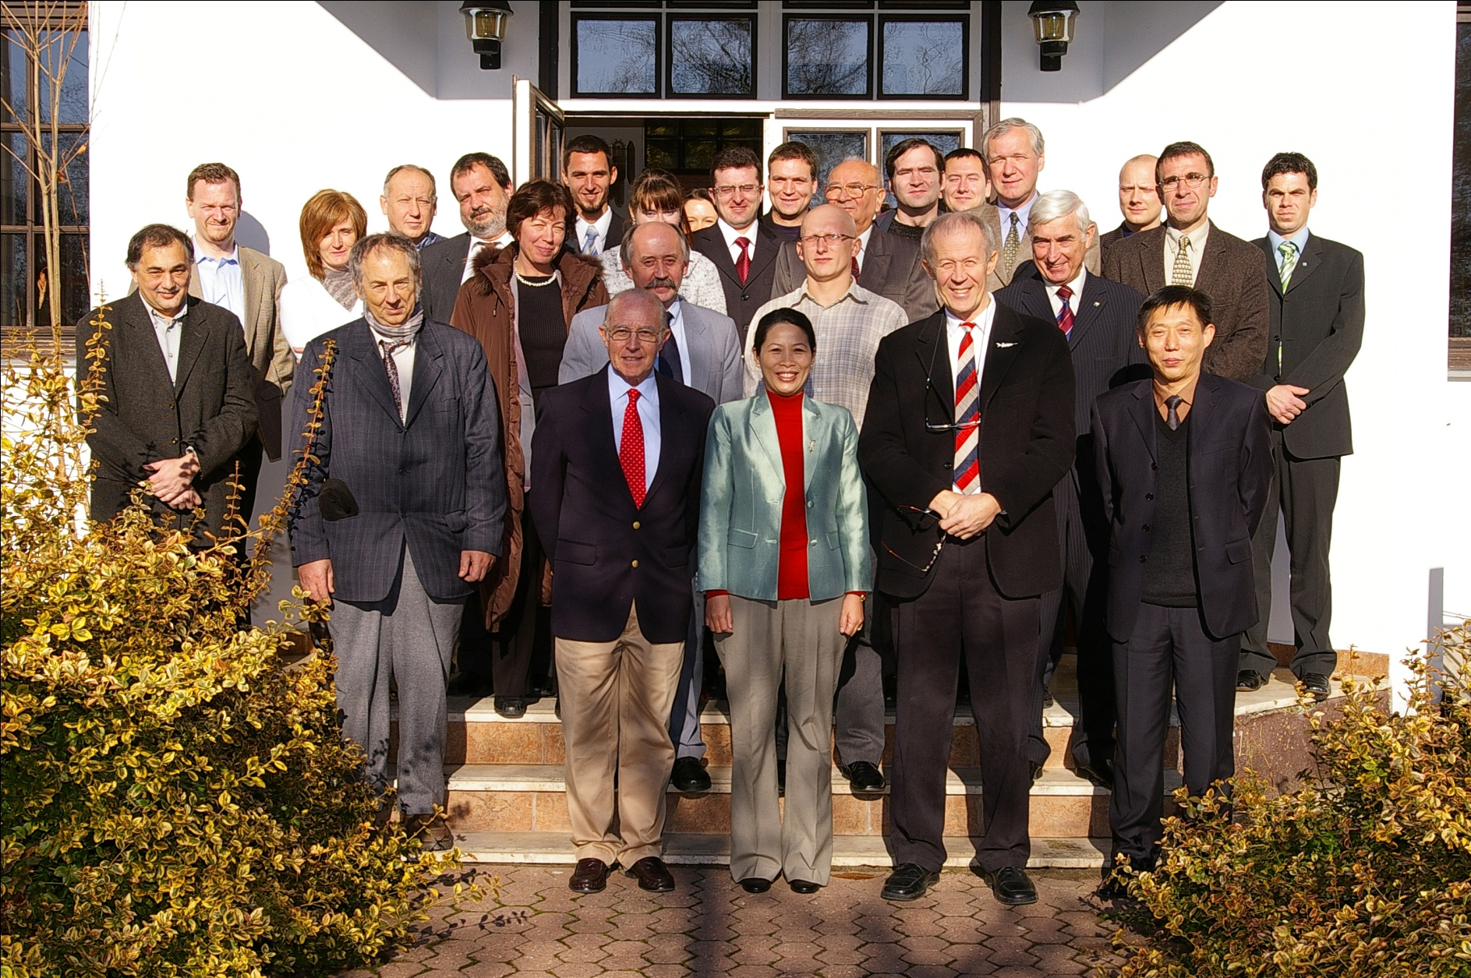
Background
FVM/HAKI-CGIAR/WFC Workshop on Characterization and Conservation of Common Carp Genetic Resources, 2007, Szarvas

Slide 6
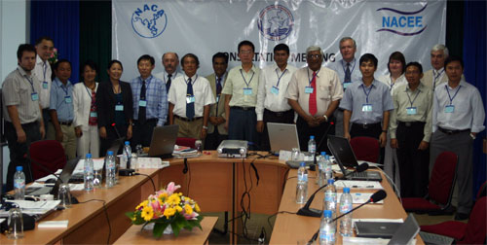
Background
NACA-NACEE consortium on freshwater finfish genetics and breeding, 2008, Ho Chi Minh City

Slide 7
Background
NACA: work on genetic resources of major carps in Asia
- expansion to the NACEE region proposed
NACEE: initiation of an FAO TCPf project on aquatic genetic resources in Central and Eastern Europe

Slide 8
FAO Technical Cooperation Programme (TCP)
Aim: providing FAO technical expertise to Member countries through targeted, short-term, catalytic projects
These projects address technical problems in the field of agriculture, fisheries, forestry and rural livelihood that prevent Member countries, either individually or collectively, from implementing their development programmes
TCP projects should produce tangible and immediate results in a cost-effective manner. They support improved food security and poverty alleviation, and should catalyse long-term development changes.

Slide 9
TCP Facility (TCPf)
Aim: to respond to government requests for urgent small-scale technical assistance activities
Umbrella project addressing multiple requests for specific and very short-term assistance in a technical area
Objectives: rapidly solving a specific technical problem for which the expertise may not be immediately available within government services;
formulating project proposals or documents for submission to potential funding sources, including TCP ;
preparing background documents, or carrying out small sector- and subsector-related studies or assessments.

Slide 10
TCP Facility (TCPf)
There can be only one TCPf project per country/region/subregion and per biennium
Maximum funding: 200,000 USD/biennium

Slide 11
TCPf project: “Responsible use and development of aquatic genetic resources in the Central and Eastern European and the Caucasus Region: status and needs for capacity development”
Duration: 2 years
Participants: countries of NACEE and the Caucasus region
Objectives : To assess the use and development of aquatic genetic resources in Central and Eastern Europe
To develop a country-wise sub-regional inventory for currently or potentially used aquatic genetic resources
To identify the status and needs for capacity development regarding the management of aquatic genetic resources in Central and Eastern Europe.
Output: outline of a comprehensive regional project

Slide 12
TCPf project: “Responsible use and development of aquatic genetic resources in the Central and Eastern European and the Caucasus Region: status and needs for capacity development”
Official request forthe project should be received from the line ministries/responsible agencies of at least three countries
Contacted: Albania, Belarus, Moldova, Ukraine
Armenia, Georgia
To the moment, request received only from Moldova, efforts are made to speed up the process

Slide 13
Thank you for your attention

