Slide 1
Vialto Consulting Áron Nemes Managing Partner
ADDED VALUE
STRATEGIC APPROACH
COOPERATION
COMPLEX METHODOLOGY
EXPERTISE
CLIENT FOCUS

Slide 2
Strategic and IT Consultancy worldwide
2013
Gold and Silver Medals of Constantinus International Award
– honoured by the ICMCI
2012
“Consulting Project of the Year” - Gabriel Al-Salem International Award for Excellence in Consulting
"Excellent Consultant of the
Year " – awarded by the Budapest Chamber of Commerce and Industry
2011
„Silver Medal of the Constantinus Global Management Consulting Award” – honoured by the ICMCI
Budapest
Skopje
Ankara
Baku

Slide 3
Complex approach and skills
Management and IT consultancy
To bring out the best
Knowledge, Project execution challanges
Mediation between vendors and local needs
Wide vendor network
Database with 1500 experts and partners
Technological knowledge
Understanding of local business environment
International business experience
Knowledge in different financing solutions

Slide 4
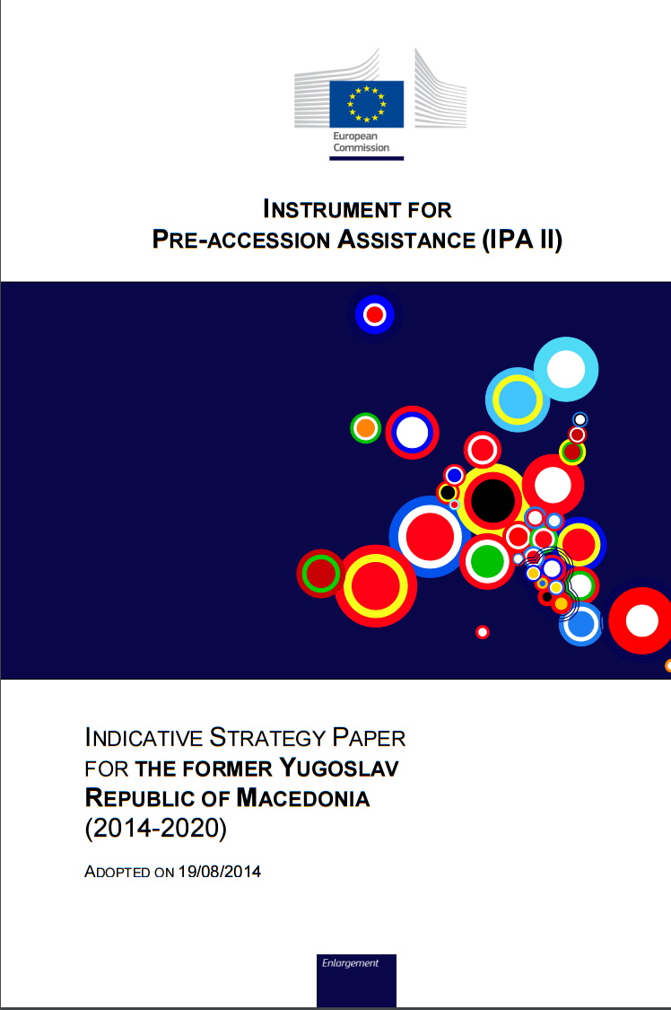
Relevant EU policies - I
Enlargement Policy
Albania, Macedonia, Montenegro, Serbia, Turkey, Bosnia, Kosovo
Instrument for Pre-accession Assistance (IPA, IPA-II)
Indicative Strategy Papers 2014-2020 separate for each country involved

Slide 5
Enlargement Policy areas
Reforms in preparation for Union membership
Socio-economic and Regional development
Employment, social policies, education, promotion of gender equality, and human resources development
Agriculture and rural development (mEUR)
 | 2014-2017 | 2018-2020
Albania | 40 | 52
Kosovo | 43.7 | 36
Macedonia | 50.3 | 56
Montenegro | 24.7 | 27.7
Serbia | 80 | 130
Turkey | 408 | 504.2

Slide 6
Relevant EU policies - II
EU Neighbourhood Policy
Eastern Partnership (Armenia, Azerbaijan, Belarus, Georgia, Moldova and Ukraine)
Southern Neighbourhood (Algeria, Egypt, Israel, Jordan, Lebanon, Libya, Morocco, Palestine*, Syria and Tunisia)
European Neighbourhood Instrument (ENI replacing ENPI)

Slide 7
Neighbourhood Instrument
How it works?
Single Support Framework
3 priorities defined (Half of the countries include Rural and agriculture development)
Overall indicative budget range is given
Annual Action Programme (AAP)
Currently AAP-2011 projects are running, financed by ENPI (2007-2014)
Last AAP is approved: AAP-2015

Slide 8
Process of EuropeAid tendering
Tendering and project delivery
4 – 6 years
Tendering Phase
Project Delivery Phase
Tendering Phase
2 – 3 years
1 year
Programming
(Project
Preparation)
Publishing
Tender
Launch
Tender
Opening
Evaluation of
Expression of
Interest (EoI)
Proposal
Preparation
Evaluation of
Proposals
Financing Agreement
Project Fiché
PIN
SCN
Shortlist Notice,
Request for Proposal
Proposal
Contract Award Notice
Programming
Inititation phase
1st Evaluation - Application
phase
2nd Evaluation - Proposal
phase

