Slide 1
AgroWeb Uzbekistan
Development and Improvement of Agro-information System in Uzbekistan
Regional Capacity Workshop on National e-Agriculture Strategies in Europe and Central Asia
22-24 June 2015, Budapest, Hungary
Sarvar Mustafaev
Iroda Rustamova PhD
Uzbekistan

Slide 2
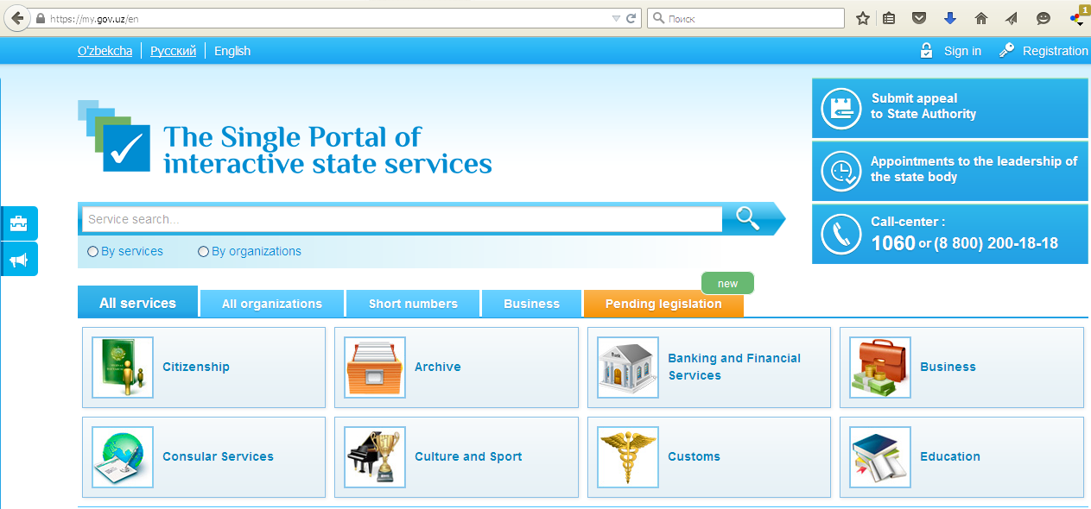
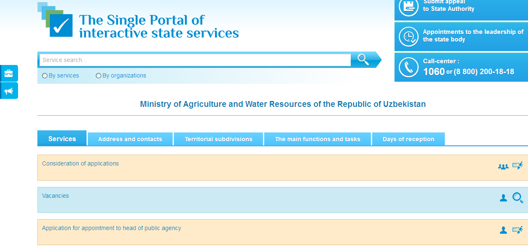
1
http://www.gov.uz

Slide 3
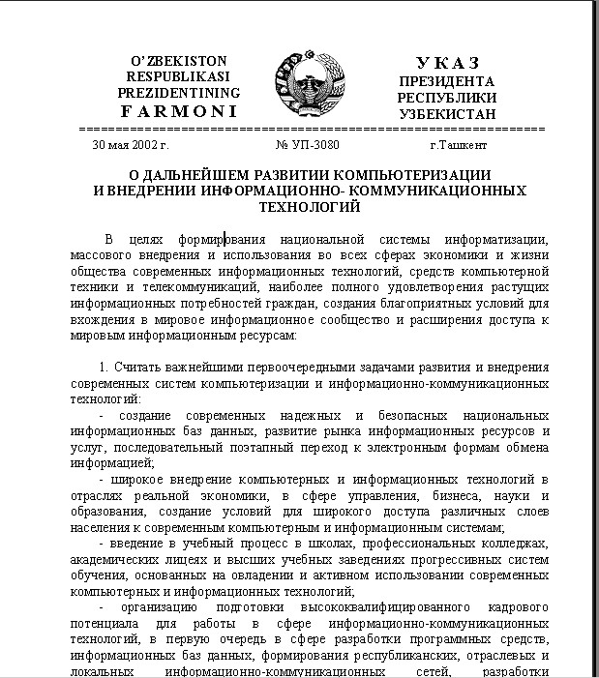
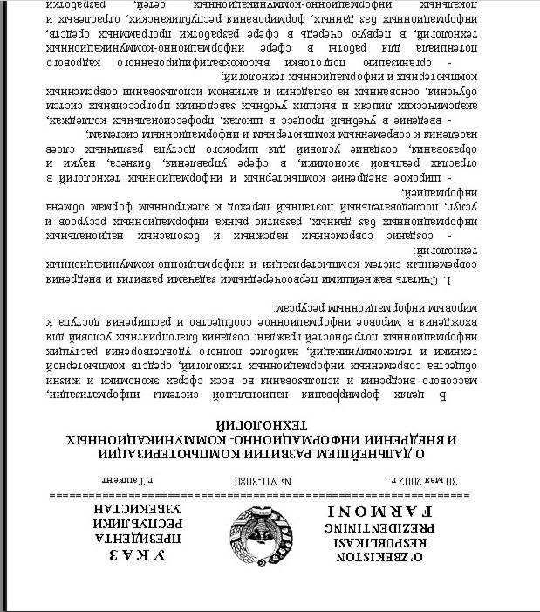
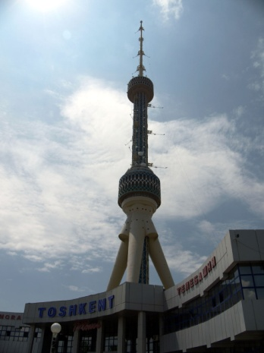
2
Regulatory support
The Laws Of The Republic Of Uzbekistan: "On Informatization" "On electronic digital signature" "On electronic document flow" "On electronic Commerce"

Slide 4
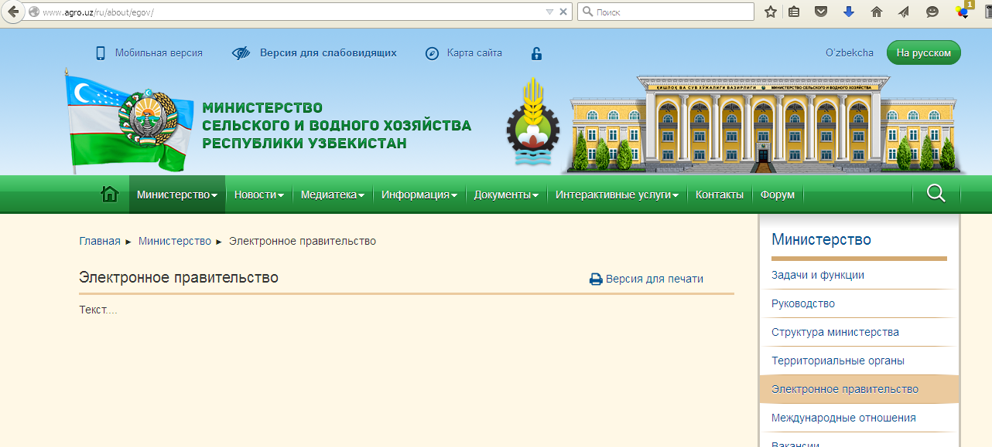
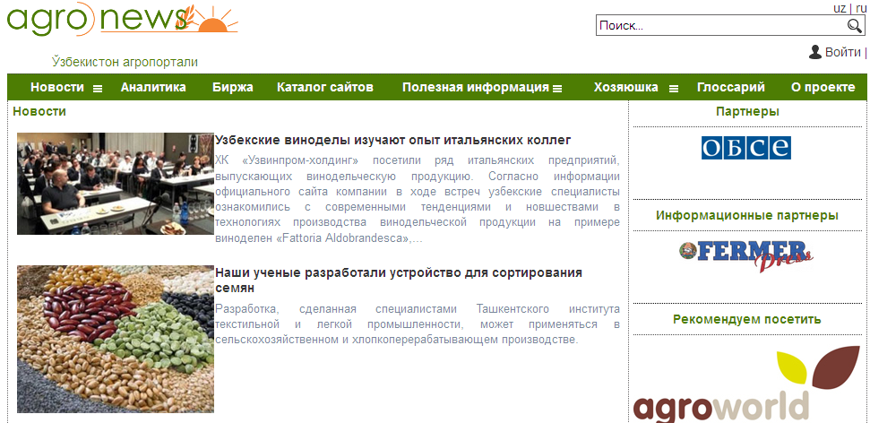
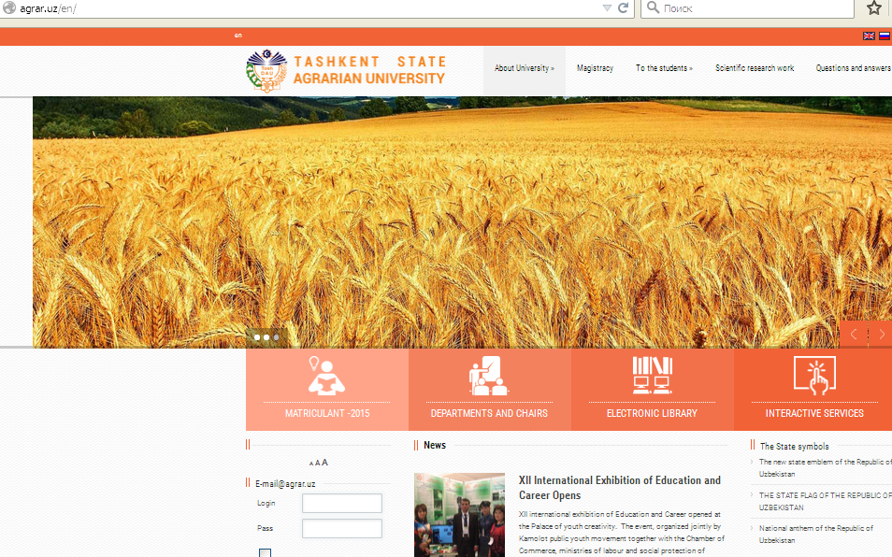
3
www.agro.uz
http://agrar.uz/
http://www.agronews.uz

Slide 5
WHAT IS THE PRODUCT
4
Links to Internet resources on agricultural topics
www.agrowebcee.net/awuz
Tashkent State Agrarian University
Stronghold agro information system of Uzbekistan
Recommendations for farmers
www.agriculture.uz
Data base on innovations
Publications in journals, conferences, seminars

Slide 6
5
MAIN USERS OF PORTAL AGROWEB UZBEKISTAN
Farmers;
Research institutions;
Higher education institutions;
Ministry of agriculture and water management;
Uzbek Research-and-production center in agriculture;
Council of farmers of Uzbekistan;
Departments and institutions of the agrarian sector;

Slide 7
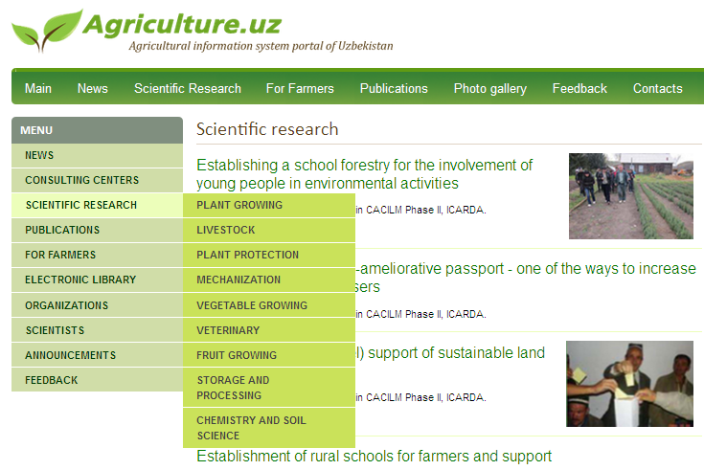
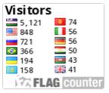
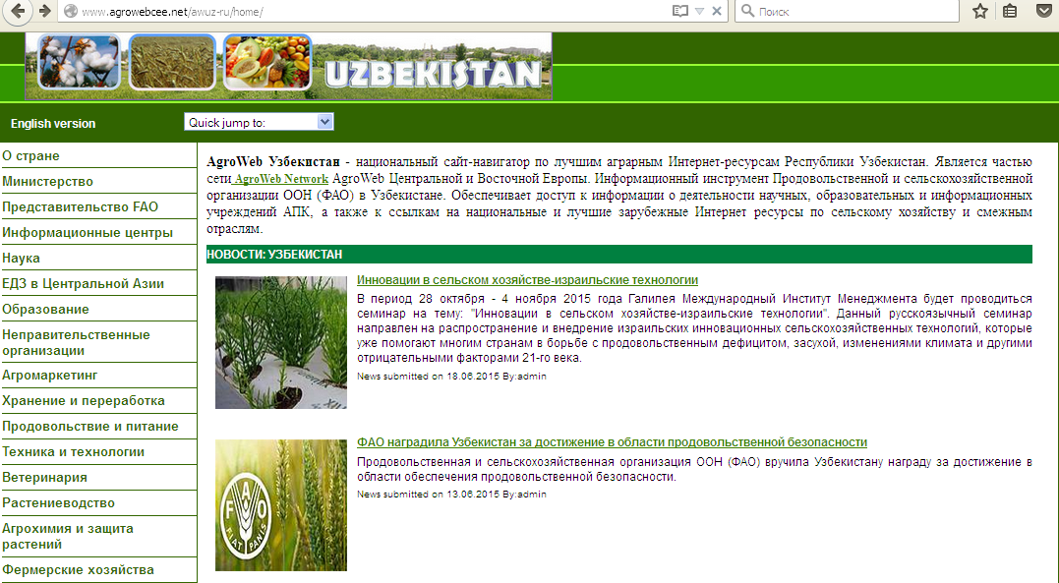
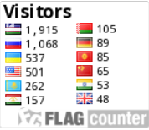
WHAT IS THE INNOVATION
6
20.02.2013-20.06.2015
20.08.2012-20.06.2015

Slide 8
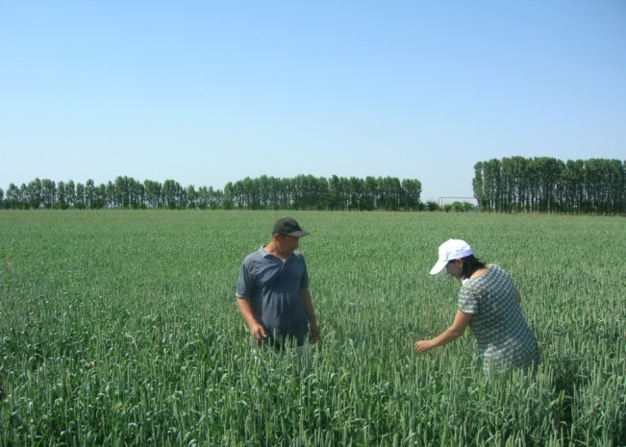
7
SUCCESS FACTORS
High yielding seeds for
12 ga
Getting Harvest per 1000 ga

Slide 9
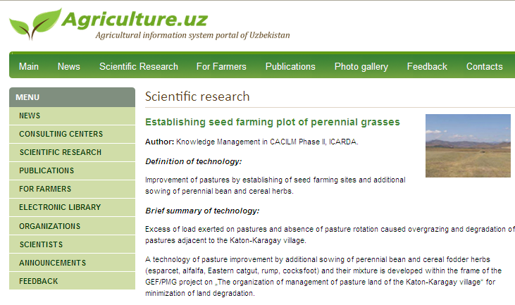
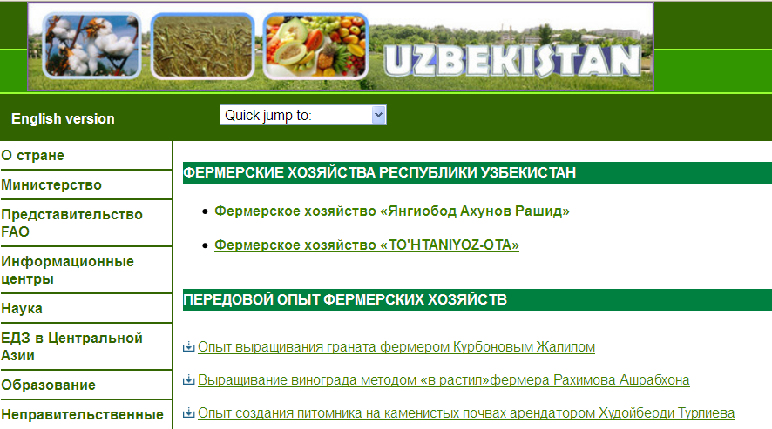
LESSONS LEARNED
8

Slide 10
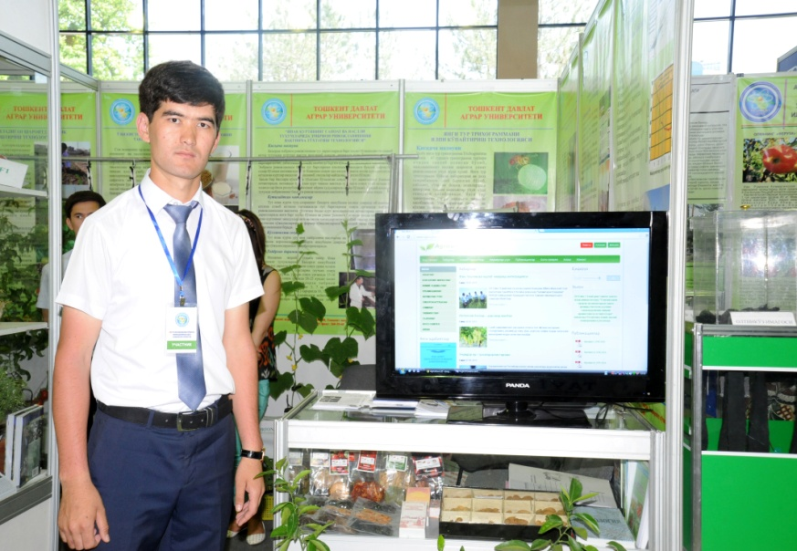
9
MAIN RESULTS
Database on innovations;
Electronic library;
Publishing of magazines and Newspapers;
Publication of proceedings of conferences and seminars;
Constant participation at the Republican fair of innovative ideas, projects and technologies.

Slide 11
Thank you so much for your kind attention
For further information contact us:
extensionuz@mail.ru
and/or visit our website:
www. agriculture.uz
www.agrowebcee.net/awuz

